Slide 1
Sales Performance Analysis of Walmart Stores Using Advanced MySQL Techniques
Project Title:

Slide 2
Business Problem:
Walmart aims to optimize its sales strategies.
Analyze historical transaction data.
Answer questions related to branches, customer types, payment methods, and product lines.

Slide 3
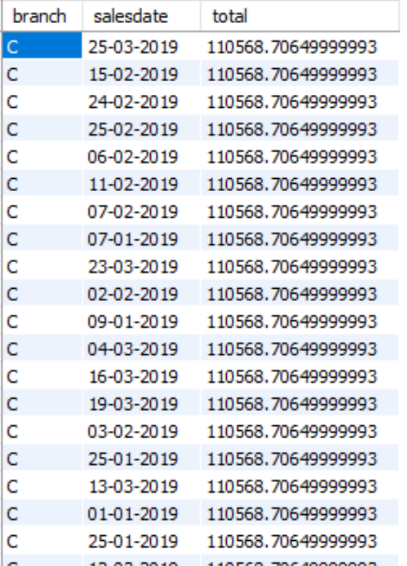
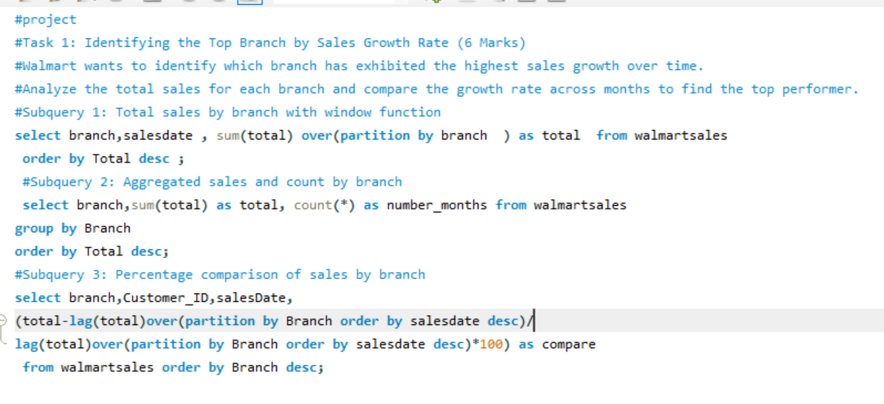
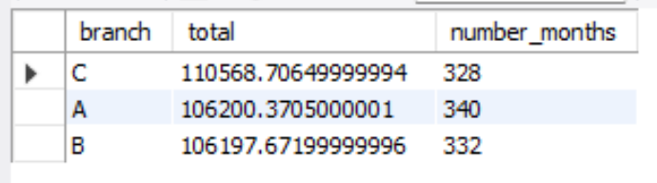
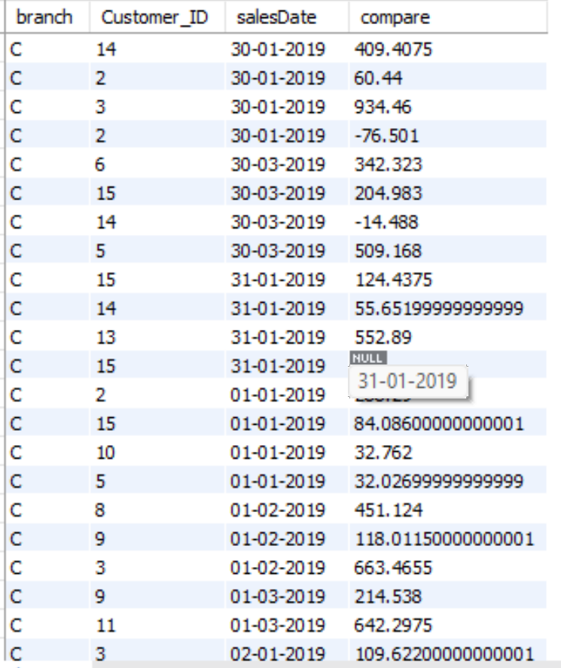
Out put:
Task 1: Identifying the Top Branch by Sales Growth Rate Walmart wants to identify which branch has exhibited the highest sales growth over time.

Slide 4
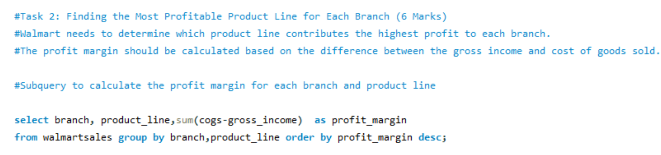
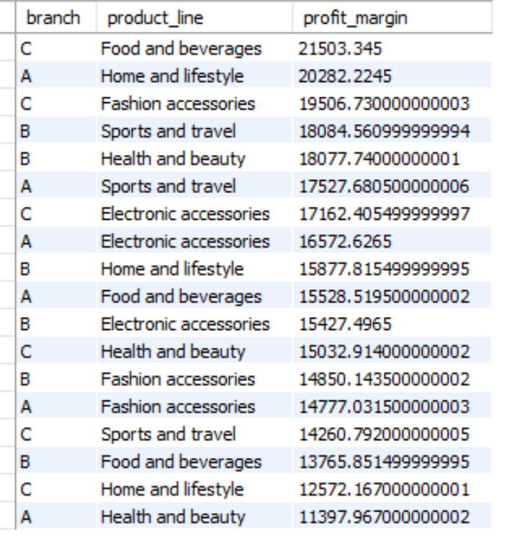
Task 2: Finding the Most Profitable Product Line for Each Branch
Walmart needs to determine which product line contributes the highest profit to each Branch.
The profit margin should be calculated based on the difference between the gross income and cost of goods sold.
Out put:

Slide 5
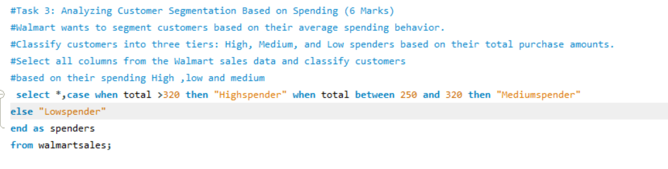
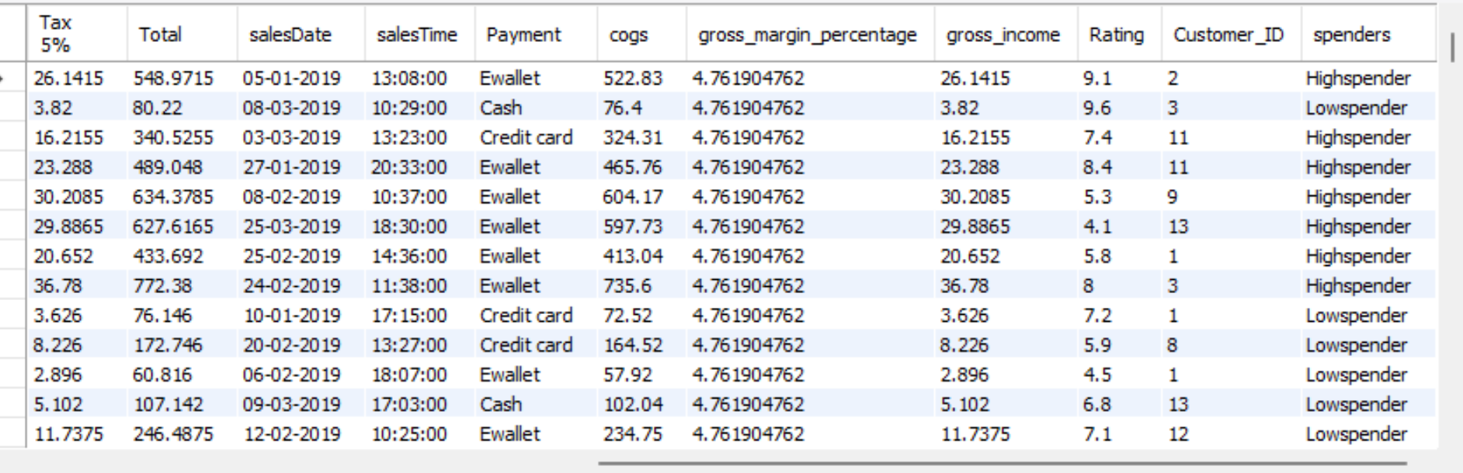
Task 3: Analyzing Customer Segmentation Based on Spending
Walmart wants to segment customers based on their average spending Behavior. Classify customers into three tiers: High, Medium, and Low spenders based on their total purchase amounts.
Out put:

Slide 6
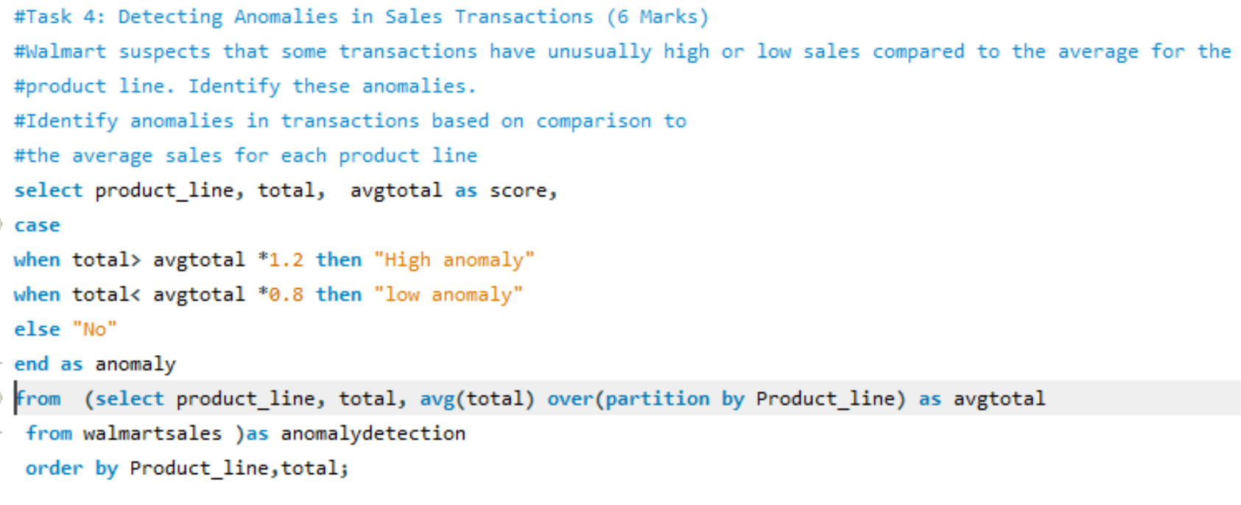
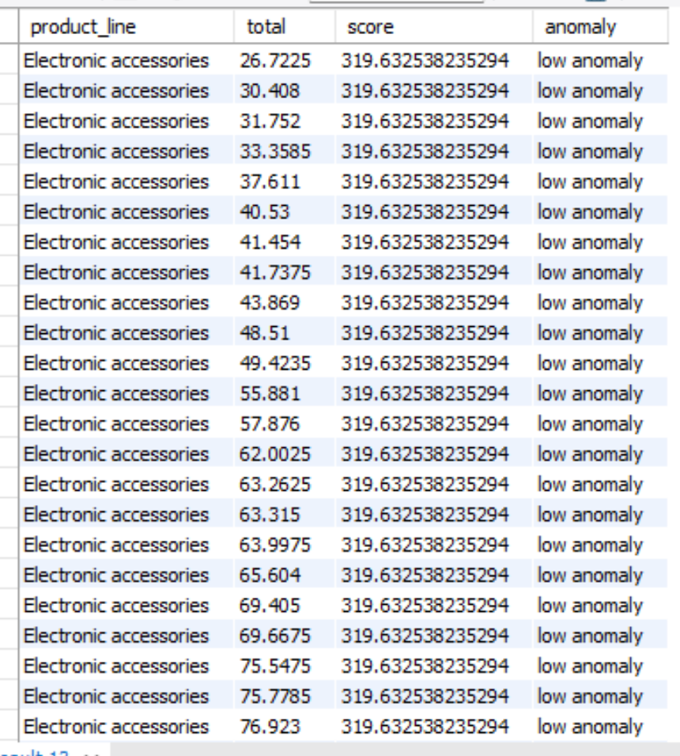
Task 4: Detecting Anomalies in Sales Transactions
Walmart suspects that some transactions have unusually high or low sales compared to the average for the product line. Identify these anomalies.
Out put:

Slide 7
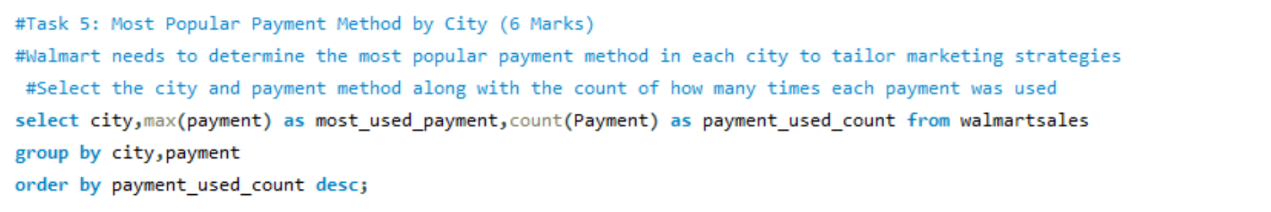
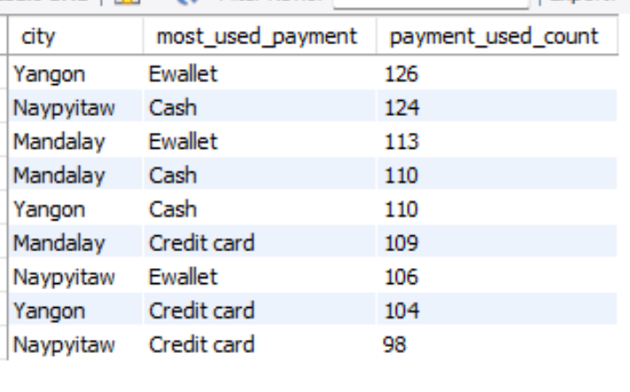
Task 5: Most Popular Payment Method by City (6 Marks) Walmart needs to determine the most popular payment method in each city to tailor marketing strategies.
Out put:

Slide 8
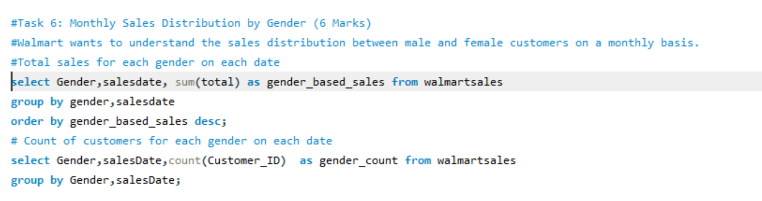
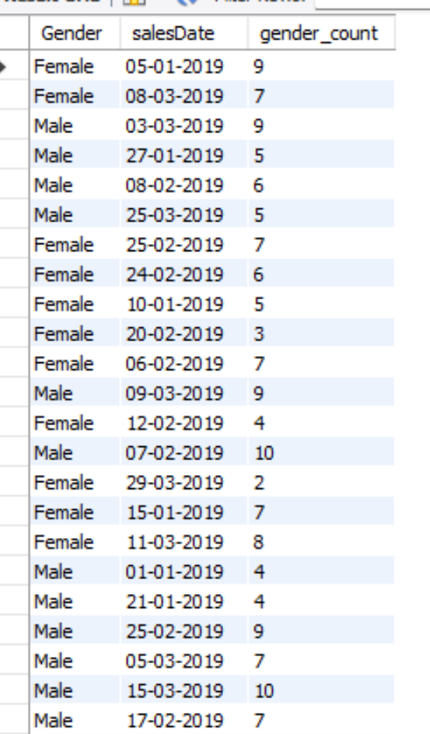
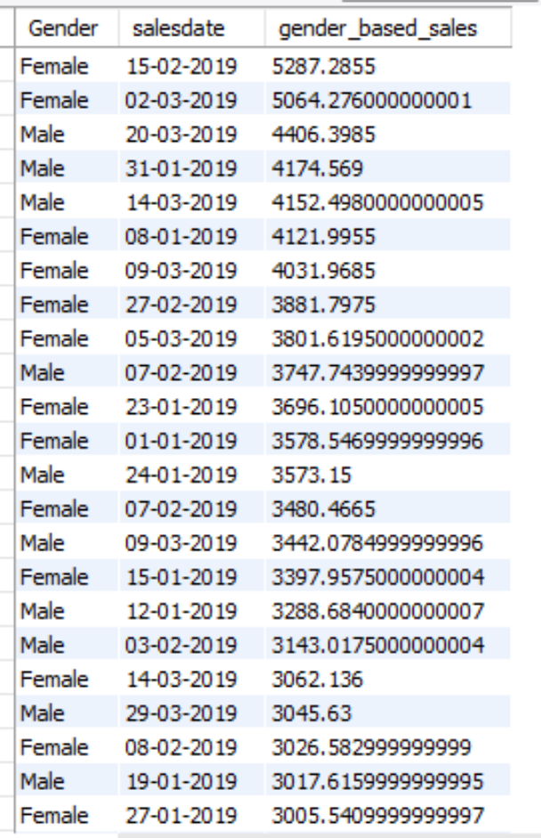
Task 6: Monthly Sales Distribution by Gender
Walmart wants to understand the sales distribution between male and female customers on a monthly basis.
Out put:

Slide 9
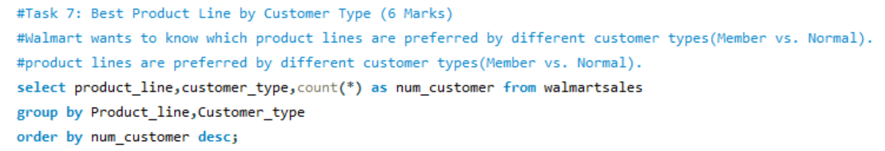
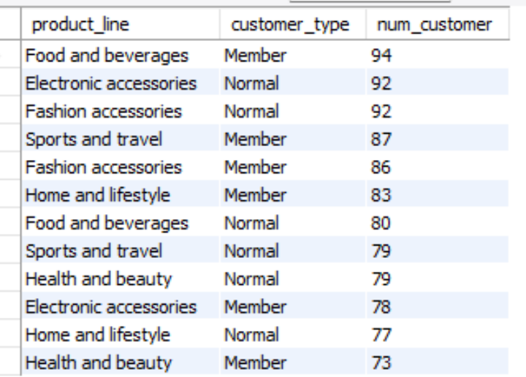
Task 7: Best Product Line by Customer Type
Walmart wants to know which product lines are preferred by different customer types(Member vs. Normal).
Out put:

Slide 10
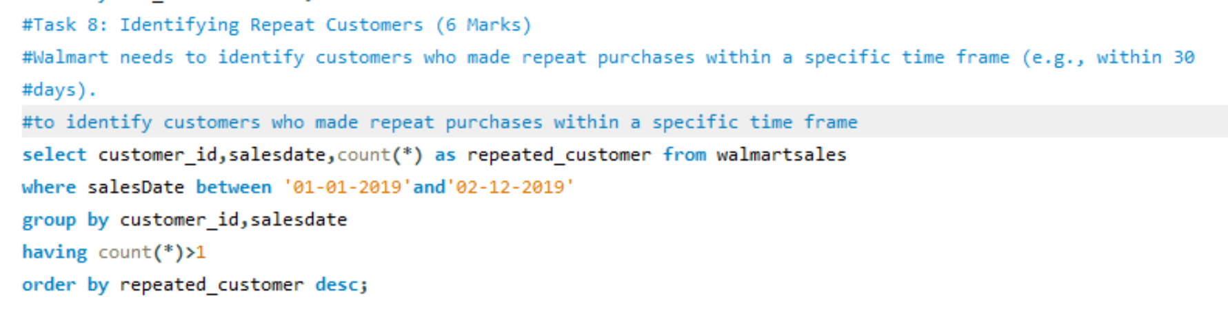
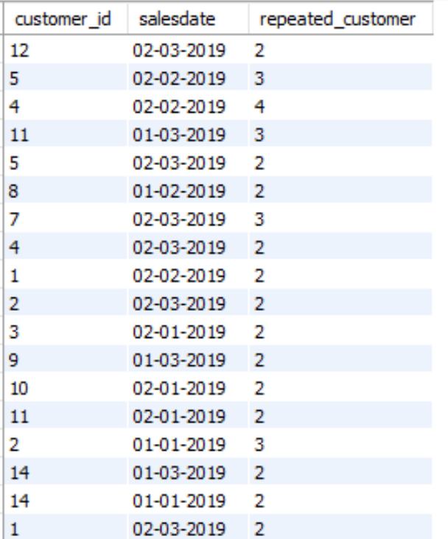
Task 8: Identifying Repeat Customers
Walmart needs to identify customers who made repeat purchases within a specific time frame (e.g., within 30 days).
Out put:

Slide 11
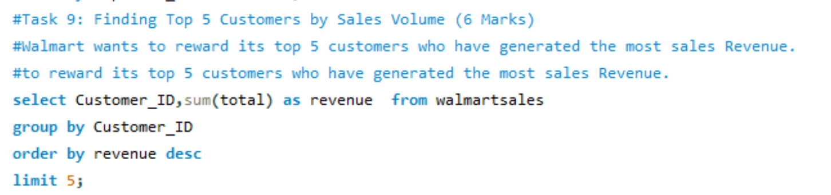
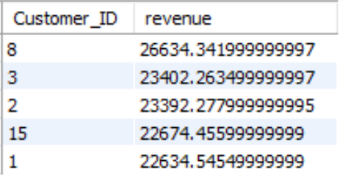
Task 9: Finding Top 5 Customers by Sales Volume
Walmart wants to reward its top 5 customers who have generated the most sales Revenue.
Out put:

Slide 12
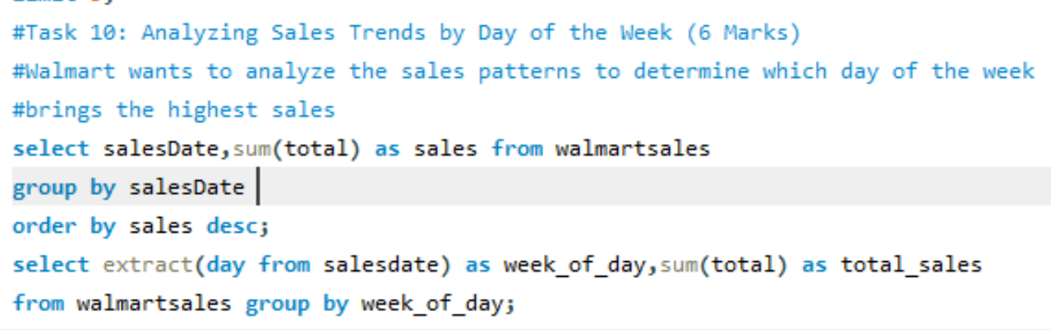
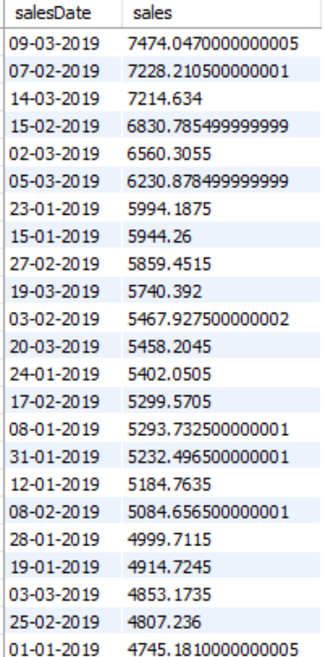
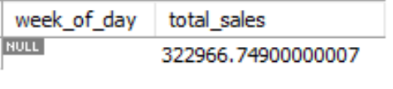
Task 10: Analyzing Sales Trends by Day of the Week
Walmart wants to analyze the sales patterns to determine which day of the week brings the highest sales.
Out put:

Slide 13
Conclusion
Through this project, I have gained significant experience in analyzing Walmart's sales data and deriving meaningful insights. This work has allowed me to:
Enhance SQL Skills: I mastered advanced SQL techniques, including window functions, subqueries, and grouping, to solve complex queries effectively.
Understand Sales Patterns: I learned how to identify trends, segment customers, and detect anomalies in real-world data.
Solve Real-Time Business Problems: By addressing Walmart's business questions, I developed the ability to apply analytical methods to practical scenarios, supporting data-driven decision-making.

